Slide 1
UCI Data 類別資料分析
Data set :Contraceptive Method Choice
第一組：林文國、曹珈嘉、王維德

Slide 2
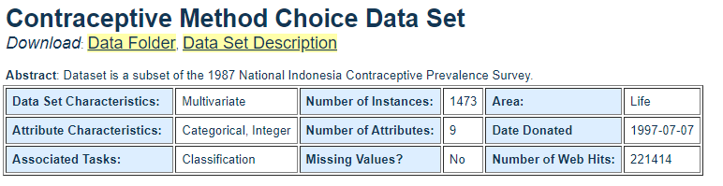
資料集資訊
Data Set Information:
This dataset is a subset of the 1987 National Indonesia Contraceptive Prevalence Survey. The samples are married women who were either not pregnant or do not know if they were at the time of interview. The problem is to predict the current contraceptive method choice (no use, long-term methods, or short-term methods) of a woman based on her demographic and socio-economic characteristics.

Slide 3
資料集資訊
Attribute Information:
1. Wife‘s age (numerical) 妻子年齡 2. Wife’s education (categorical) 1=low, 2, 3, 4=high 妻子教育程度 3. Husband‘s education (categorical) 1=low, 2, 3, 4=high 丈夫教育程度 4. Number of children ever born (numerical) 曾經出生的小孩個數 5. Wife’s religion (binary) 0=Non-Islam, 1=Islam 妻子宗教信仰 (0=非伊斯蘭教，1=伊斯蘭教) 6. Wife‘s now working? (binary) 0=Yes, 1=No 妻子現在是否在工作 7. Husband’s occupation (categorical) 1, 2, 3, 4 丈夫的職業 8. Standard-of-living index (categorical) 1=low, 2, 3, 4=high 生活水平指數 9. Media exposure (binary) 0=Good, 1=Not good 媒體接觸 10. Contraceptive method used (class attribute) 1=No-use, 2=Long-term, 3=Short-term
曾使用的避孕方法

Slide 4

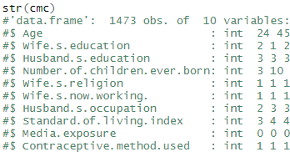
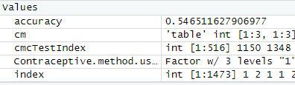
資料型態轉換

Slide 5
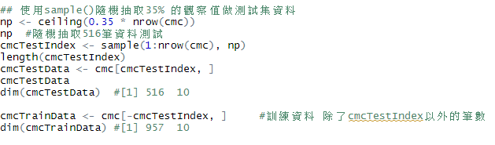
訓練模型
myFormula <-cmcTrainData$Contraceptive.method.used ~ Wife.s.education + Number.of.children.ever.born + Wife.s.now.working. + Age
cmc_ctree <- ctree(myFormula, data = cmcTrainData)

Slide 6
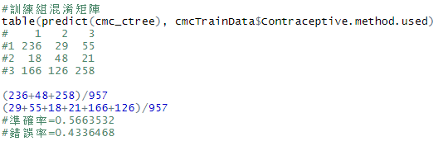
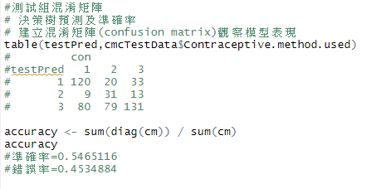
混淆矩陣

Slide 7
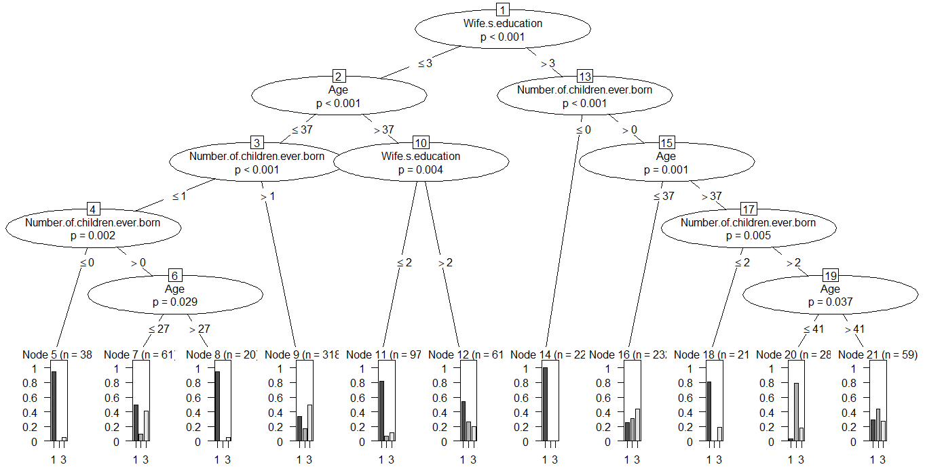
決策樹(上)

Slide 8
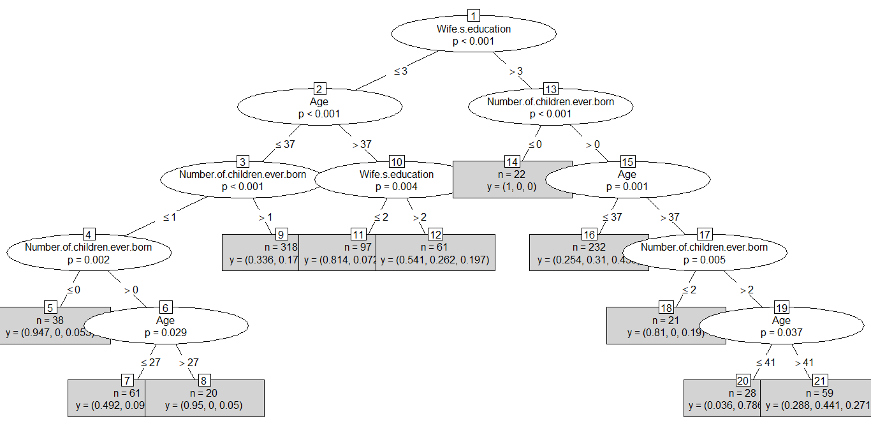
決策樹(下)

Slide 9
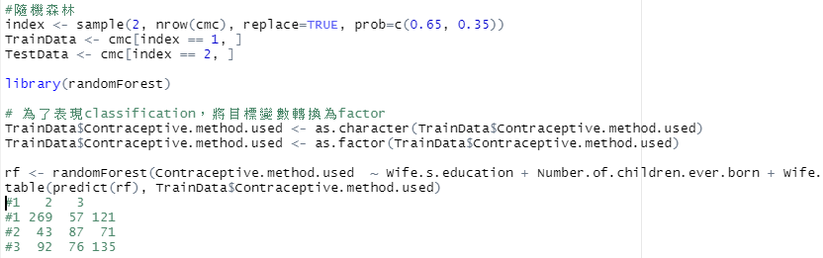
隨機森林

Slide 10
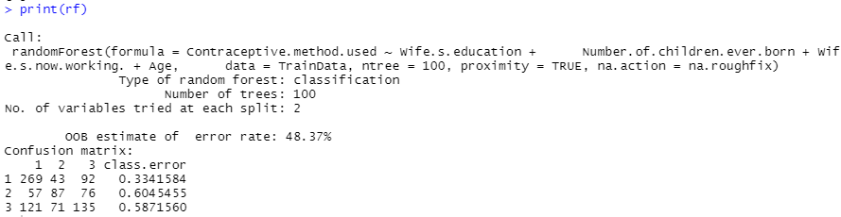
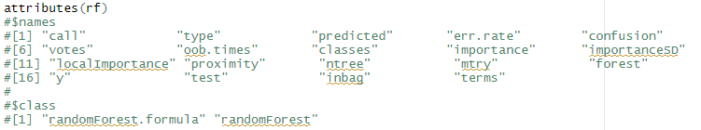
隨機森林

Slide 11
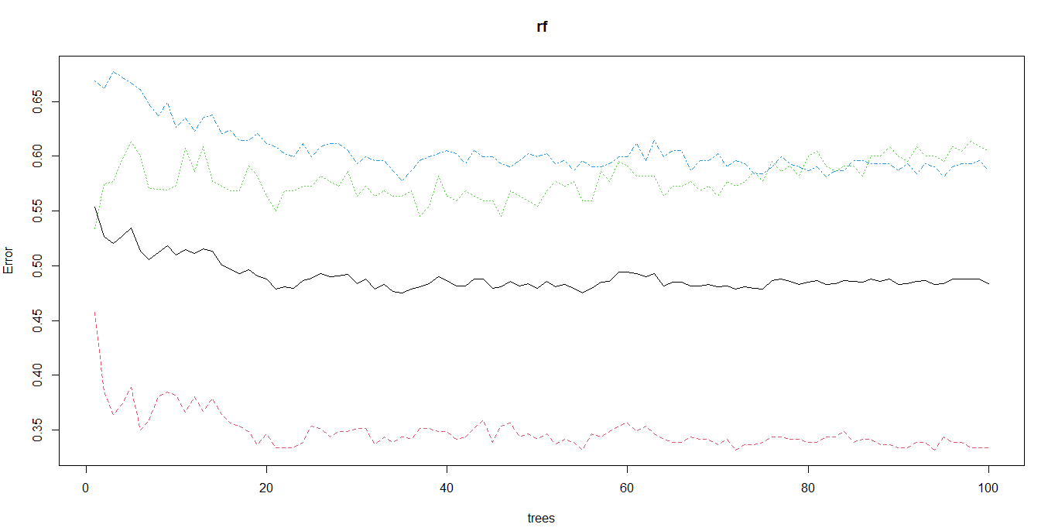
隨機森林

Slide 12
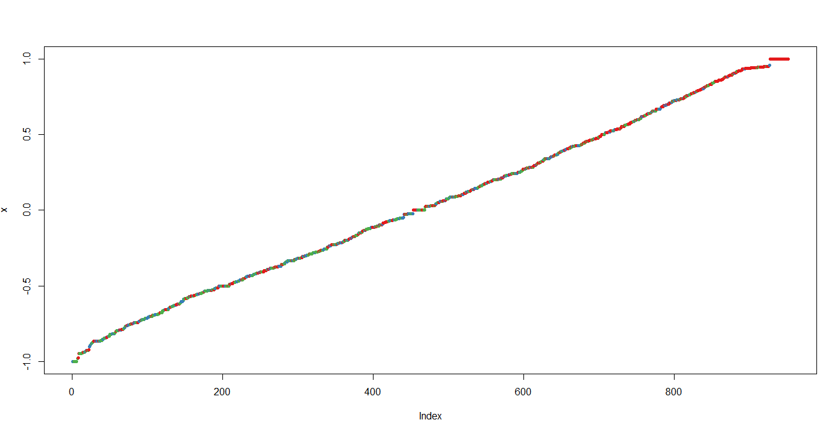
隨機森林

Slide 13
Thank you.

